Slide 1
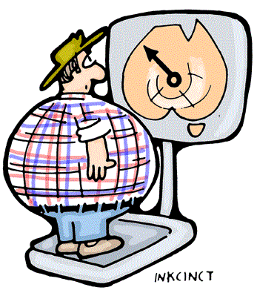
Anesthetic considerations in obesity and bariatric surgery
Dr. Deepti Agarwal
Senior Resident
KMC, Manipal
Notes:
The prevalence of obesity is increasing in India bcoz of modern lifestyles and better standards of living. Obesity is a multisystem disorder, and so requires a multidisciplinary approach. We all , in anesthesia, are daily dealing with these obese patients scheduled for various surgeries. So today I will give u a broad overview of pathophysiological and practical considerations for anesthetizing such patients posted for bariatric as well as non bariatric surgeries.

Slide 2
Obesity
A metabolic disease in which adipose tissue comprises a greater than normal proportion of body weight.
Primarily induced and sustained by an over consumption or under utilization of caloric substrate.
Genetic, behavioral, cultural and socioeconomic factors.
Reduces quality of life and life expectancy.
Increased healthcare services demands.
Notes:
Genetic: prader willi, lawrence moon biedl,leptin deficiency
Metabolic factors: hormones peptides…. Not well understood

Slide 3
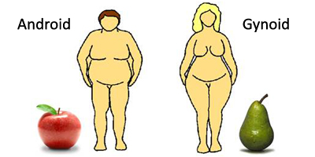
Types of obesity
Android/Central | Gynecoid/Peripheral
Adipose tissue predominantly in upper body | Mainly in hips, buttocks n thighs
This fat more metabolically active so high oxygen consumption | Less oxygen consumption
Increased incidence of cardiovascular ds. | Less associated with CVS risk
More common in males | More in females

Slide 4
Terms for describing pt’s weight:-
Total body weight:- The actual wt. of the pt.
Ideal body weight:- What the patient should weigh with a normal ratio of lean to fat mass. Calculated by Broca’s index
IBW(kg)=Ht.(cm) – x (where x=105 in females and 100 in males).
Lean body weight:- The pt’s wt. excluding fat.
LBW(kg)= 9270 x TBW(kg) . ( 216 for men and 244 for women) { Janmahastian et al }
6680+(216/244 x BMI (kg/m2)
Adjusted body weight:- calculated by adding 40% of the excess weight to the IBW
ABW(kg)= IBW(kg) + 0.4 {TBW (kg) – IBW (kg)}
Notes:
ABW takes into account the fact that obese individuals have increased lean body mass n increased Vd for drugs.

Slide 5
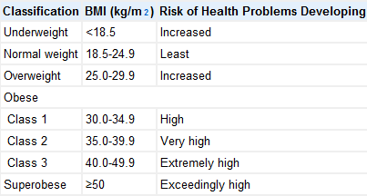
Measuring Scales for obesity
Body mass index (Quetelet's index) =[weight(kg)/height(m2)]
Notes:
To estimate degree of obesity

Slide 6
Other parameters:
Waist circumference:- correlates with abdominal fat.
High risk: Male > 102 cm, Female > 88cm.
Waist to hip ratio:-
High risk: >0.9 in males, >1 in females.

Slide 7
Comorbidities
Stroke
HTN
Nonalcoholic steatohepatitis
Obesity
DM
OSA
Hypothyroid
OHS
IHD

Slide 8
Pathophysiology
Total blood volume is increased in obese (70ml/kg), most of the extra volume distributed to adipose tissue.
Resting blood flow to fat is 2 to 3 ml/100gm/min.
With increasing obesity the percentage of perfusion to fat decreases. {i.e not in direct proportion}
1 kg increase in fat above IBW needs 20 to 30 ml increase in cardiac output.
For every 13.5 kg of fat added, app. 25 miles of neovascularisation is added to the body.
Notes:
Normal TBV is 50ml/kg. renal n splanchnic blood flows r also increased.
2.36ml/100gm/min to 1.53ml/100gm/min if % of fat increases from 20 to 36% of the body weight.
Increase in cardiac output is due to ventricular dilation n increase in stroke volume.

Slide 9
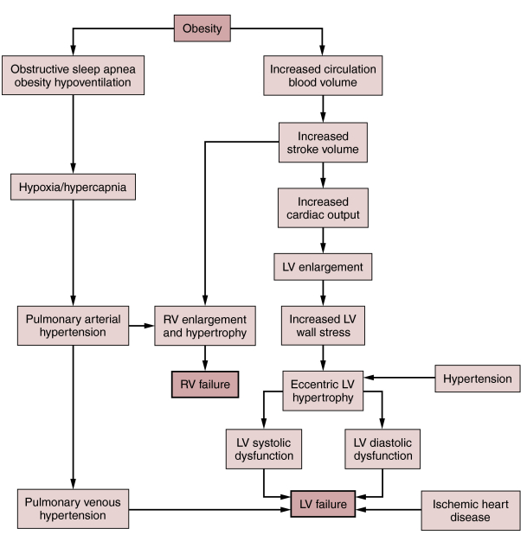
Cardiovascular system
Notes:
B.P increases by 6.5 mm Hg for every 10% greater body weight.
With LV hypertrophy, decrease compliance,. Due to impaired filling i.e diastolic dysfunc LVEDP increase n pulmonary edema develops.
First diastolic dysfunction, After sumtym LV wall thickening fails to keep pace with dilatation l/to systolic dysfunction (obesity cardiomyopathy) n eventual biventricular failure.
Obesity again accelerates atherosclerosis, increased risk of IHD again leading to LV failure.

Slide 10
CVS….. (contd.)
Cardiac dysrhythmias
Mild to moderate hypertension (3-4mmHg↑in SBP n 2mmHg ↑in DBP for every 10kg of wt. gained)
Dyslipidemia
Hypercoaguability : Obese individuals have higher levels of Fibrinogen, Factor VII, Factor VIII, Von Willebrand Factor, And Plasminogen Activator Inhibitor-1 (PAI-1).
Varicose veins, Thromboembolism.
Notes:
Fatty infiltration of conduction system, hypoxia, hypercapnia, electrolyte imbalance, CAD, increased circulatory catecholamines, OSA, myocardial hypertrophy.
HTN d/to increased circulating levels of angiotensinogen, aldosterone n ACE. Other factors are hyperinsulinemia which activates sympathetic nervous system l/to Na retention n HTN.
Dyslipidemia d/to release of various bioactive mediators.
ot

Slide 11
RESPIRATORY SYSTEM
Restrictive lung disease
Obesity hypoventilation syndrome (OHS)
Obstructive sleep apnea (OSA)
Pulmonary Hypertension

Slide 12
Restrictive lung disease
Increased fat
Decreased respiratory muscle function
Increased pulmonary blood flow
Decreased chest wall compliance
Increased elastic resistance
Decreased lung compliance
↑in total blood volume and pulmonary blood volume
Decreased total respiratory compliance in supine position ↓FRC, ↓VC, ↓TLC (RV n closing capacity unchanged)
Polycythemia
Chronic hypoxemia
Shallow & rapid breathing
Increased work of breathing
Limited maximum ventilatory capacity
FRC below CC
Small airway closure
V/Q mismatch & right to left shunt
Arterial hypoxemia
Notes:
Increase fat accumulation on thorax n abdomen
Arterial hypoxemia----- anesthesia worsens this situation such that upto 50% reduction in FRC occurs in obese anesthesized pt. compared with 20% in nonobese patient.

Slide 13
Reduction in FRC is primarily a result of REDUCED ERV.
The relationship between FRC and closing capacity is adversely affected.
Anesthesia worsens this situation such that up to a 50% reduction in FRC occurs in the obese anesthetized patient compared with 20% in the nonobese individual.
Obesity increase O2 consumption and CO2 production at rest.
Gas exchange:- a reduction in Pa_{O2}and increases in alveolar‐to‐arterial oxygen difference and shunt fraction. These deteriorate markedly on induction of anaesthesia and high inspired fractions of oxygen are required to maintain adequate arterial oxygen tensions.
Notes:
Bcoz of metabolic activity of excess fat n increased workload on supportive tissues. The body meets these demands by increasing CO n alveolar ventilation.
Inefficient – particularly diaphragm - ↓ Strength and endurance, static max. insp. pressure – 60-70% of normal
Greater risk for inspiratory muscle fatigue at rest and with exercise
Chlif M. Int J Obes 2007
Causes
↑ Elastic load
Mechanical disadvantage - Over stretched diaphragm, resp. muscle
↓Skeletal muscle glycogen synthase activity
Sharp JT. Am Rev Respir Dis 1986
Fatty infiltration of respiratory & non respiratory muscles
Newham DJ. Clin Sci 1988

Slide 14
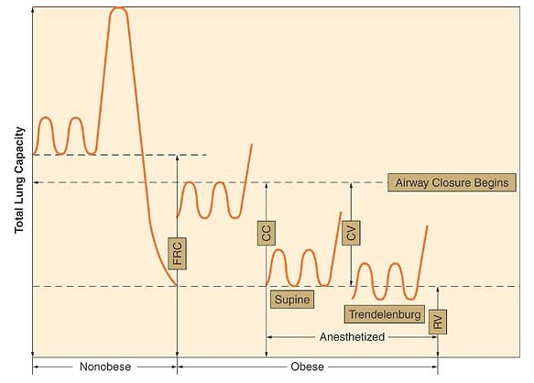

Slide 15
Obstructive sleep apnea
Complete cessation of airflow lasting > 10seconds or > 5 episodes per sleep and decrease of atleast 4% in SaO2.
Clinical sequelae such as hypoxia, hypercarbia, pulmonary and systemic hypertension, polycythemia, arrhythmias, ↑risk of IHD and stroke, corpulmonale.
Diagnosis:- polysomnography (apnea-hypopnea index)
Other parameters:- Total arousal index, Respiratory disturbance index
Patients diagnosed to have moderate/ severe OSA have to undergo CPAP prior to elective surgery
Notes:
PSG or sleep study during which pt ECG, EEG, EOG, CAPNOGRAM, BP, PHARYNGEAL N EXTREMITY EMG, SPO2, ESOPHAGEAL PRESSURE, NASAL OR ORAL AIRFLOW r recorded.
AHI quantifies severity of OSA.
AHI is the Total number of episodes of apnea and hypopnea divided by the total sleep time.
Mild : 5 to 15 events per hour
Moderate: 16 to 30 events per hour
Severe : > 30 events per hour
Obstructive sleep hypopnea:- Partial reduction of airflow of greater than 50% for atleast 10 sec or 15 or more episodes per hour of sleep and decrease in SaO2 of atleast 4% despite maintenance of neuromuscular voluntary efforts.

Slide 16
Airway
↑ amount of adipose tissues in their oral and pharyngeal tissues.
Inverse relationship between degree of obesity and pharyngeal area.
Deposition of fat in lateral pharyngeal walls decrease the size of airway and changes the shape of oropharynx to ellipse with a short transverse and long AP axis.
This contributes to airway obstruction and also increased chance of difficulty in maintaining patent airway.
Additionally, airway obstruction is likely to be complicated by use of opiates and sedatives(for postop Mx) as these drugs tend to decrease pharyngeal dilator tone and increase likelihood of upper airway collapse.
Notes:
Pharyngeal tissues including uvula, tonsils, tonsillar pillars, tongue, aryepiglottic folds and lateral pharyngeal walls

Slide 17
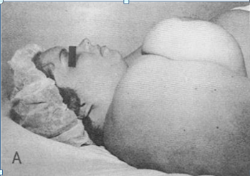
Other airway problems:-
↑ Bulk of soft tissue
Large tongue
Short thick neck, ↑ circumference (5% with a 40-cm & 35% probability at 60-cm)
High & anterior larynx
Restricted mouth opening
Limitation of cervical spine & atlanto-occipital flexion & extension
Sprasternal, presternal and posterior cervical fat.
Thick submental fat pad
Large breasts
Notes:
by upper
thoracic and low cervical fat
pads; excessive tissue folds in
the mouth and pharynx;
Short, thick neck
Suprasternal, presternal, and posterior cervical fat;
A very thick submental fat pad.

Slide 18
Obesity hypoventilation syndrome /Pickwickian syndrome
Results from long term OSA
Combination of obesity and chronic hypoventilation that ultimately results in pulmonary hypertension and cor pulmonale.
Diagnosis:- BMI >30kg/m2 and awake arterial hypercapnia (PaCO2 >45mm Hg) in the absence of known causes of hypoventilation.
Notes:
Prolonged OSA alters control of breathing l/to CNS mediated apneic events. This increases reliance on hypoxic drive for ventilation.

Slide 19
GASTROINTESTINAL SYSTEM
Gastric volume and acidity are increased.
Delayed gastric emptying
because of increased abdominal mass that causes antral distention
gastrin release
a decrease in pH with parietal cell secretion.
Increased risk of GERD and hiatal hernia
increased intragastric pressure,
Increased frequency of transient LES relaxation
Non alcoholic fatty liver disease, inflammation, focal necrosis and cirrhosis.
LFTs and histology may be abnormal but clearance usually is not reduced.
High risk of colon cancer, GB ds.
Notes:
GERD increases aspiration risk. Fasted obese pt hav gastric volume >25ml and gastric pH < 2.5 which l/to high risk of aspiration.

Slide 20
RENAL AND ENDOCRINE SYSTEMS
Impaired glucose tolerance → Type II D.M
Subclinical hypothyroidism with electrolyte imbalance
Glomerular hyperfiltration (↑RPF, ↑GFR)
Excessive weight gain causes:-
increases renal tubular resorption
impairs natriuresis through activation of the sympathetic and renin-angiotensin system as well as physical compression of the kidney.
Loss of nephron function if prolonged obesity
Increased risk of ESRD, menorrhagia, preeclampsia /eclampsia, prostate cancer, urinary incontinence.
Notes:
Loss of nephron function further impairs natriuresis n further increase in arterial pressure.

Slide 21
Metabolic syndrome
Diagnosis:- 3 of the following
Abdominal obesity (Waist > 40“ in males and > 35“ in females)
Hypertension (>130/85 mm Hg)
Triglycerides ( > 150mg/dl)
HDL Cholestrol ( <40 mg/dl in males and <50 mg/dl in females)
Impaired fasting glucose ( > 110 mg/dl)

Slide 22
Other systems:-
Musculoskeletal:-
Acanthosis nigricans
Osteoarthritis
Rheumatoid arthritis
Psychological:-
Depression
Decreased self esteem
Social stigma
Morphological changes
Positioning
Transferring
Monitoring (NIBP cuffs)
Surgical and Mechanical issues
Reduced surgical access
Difficult visualisation of underlying structures
Excess bleeding
Longer operating times
Higher risk of infection
Wound infection and wound dehiscence

Slide 23
Pharmacology
Drug dosing should take into consideration the volume of distribution (V_{D}) for administration of the loading dose, and on the clearance for the maintenance dose.
Dosing should be calculated either by LBW/TBW based on lipophilicity.
Highly lipophilic drugs----> increased Vd in obese pt. so drug doses are calculated on basis of TBW. (eg thiopental, BZDs, propofol, fentanyl, Sch, dexmedetomidine, atracurium etc.)
Weakly lipophilic drugs have unchanged Vd in obese pt. so drug doses are calculated on basis of LBW. (eg alfentanyl, ketamine, morphine, vecuronium, rocuronium).
Exceptions are lipophilic drugs with unchanged Vd and in these drug doses are calculated by LBW. (eg remifentanil)
Notes:
The physiologic changes associated with obesity may lead to alterations in the distributon, binding, and elimination of many drugs.
With certain exceptions
For maintenance if clearance values same in obese n nonobese then based on LBW, n if clearance increased than on TBW.
Remifentanyl is highly lipophilic but it has limited potential to accumulate bcoz it is rapidly metabolized by plasma esterases.

Slide 24
Pharmacokinetics:-
The V_{D} in obese patients is affected by
Reduced total body water,
Increased total body fat,
Increased lean body mass,
Altered tissue protein binding,
Increased blood volume & cardiac output,
Increased blood concentrations of free fatty acids, triglycerides, cholesterol
Lipophilicity of drugs, and
Organomegaly.
Increased Vd prolongs elimination half life even when clearance is unchanged or increased.
Notes:
Adsorption is unchanged.
The distribution of the drug is first in central compartment which is unchanged in obese pt but absolute body water content is decreased n lean body mass n adipose tissue r increased,. This all affects lipophilic and polar drug distribution.

Slide 25
Plasma protein binding (decrease free fraction of drug)
Hyperlipidemia
Increased conc. of alpha 1 glycoprotein
Drugs that undergo phase I metabolism (oxidation, reduction, hydrolysis) are generally unaffected by changes induced by obesity, while phase II reactions (glucuronidation, sulfation) are enhanced.
Increased drug clearance
Increased RBF
Increased GFR
Increased tubular secretion
Liver functions are also abnormal in obese pt. and this warrants selecting drugs that has been associated with postop liver dysfunction.

Slide 26
Treatment of obesity
Non pharmacological:- calorie restriction, behavior modification, lifestyle alteration
Pharmacological:- Indicated if BMI of ≥30 kg/m² or a BMI from 27 and 29.9 kg/m² with obesity-related co morbid disease. {National Institute of Health and the European Union}
Phentermine, Fenfluramine, Sibutramine, Orlistat, Rimonabant
Notes:
500-1000kcal/day
Goal is to reduce energy intake, increase energy utilization, decrease absorption of nutrients.

Slide 27
Surgical treatment of obesity
Surgeries performed for the treatment of morbid obesity is known as bariatric surgery
Surgery is a option for weight loss in patients with
BMI ≥ 40, or more than 100 pounds overweight.
BMI ≥35 and at least two obesity-related co-morbidities such as type II diabetes (T2DM), hypertension, sleep apnea and other respiratory disorders, non-alcoholic fatty liver disease, osteoarthritis, lipid abnormalities, gastrointestinal disorders, or heart disease.
Inability to achieve a healthy weight loss sustained for a period of time with prior weight loss efforts.
{American Society of Bariatric Surgery}

Slide 28
Surgical strategies:-
Malabsorptive bariatric procedures:-
Jejunoileal bypass
Biliopancreatic division
Restrictive bariatric procedures:
Vertical banded gastroplasty (VBG)
Adjustable gastric banding (AGB)
Sleeve gastrectomy
Combined
Roux en Y gastric bypass (RYGB)
Notes:
Can be done either by laparotomy incision or laproscopically.
Malabsorptive procedure cause wt loss by gastric restriction and malabsorption of nutrients. They leads to vitamin n protein malabsorption, osteoporosis, hepatic faiure. So these surgeries r rarely used now a days.

Slide 29
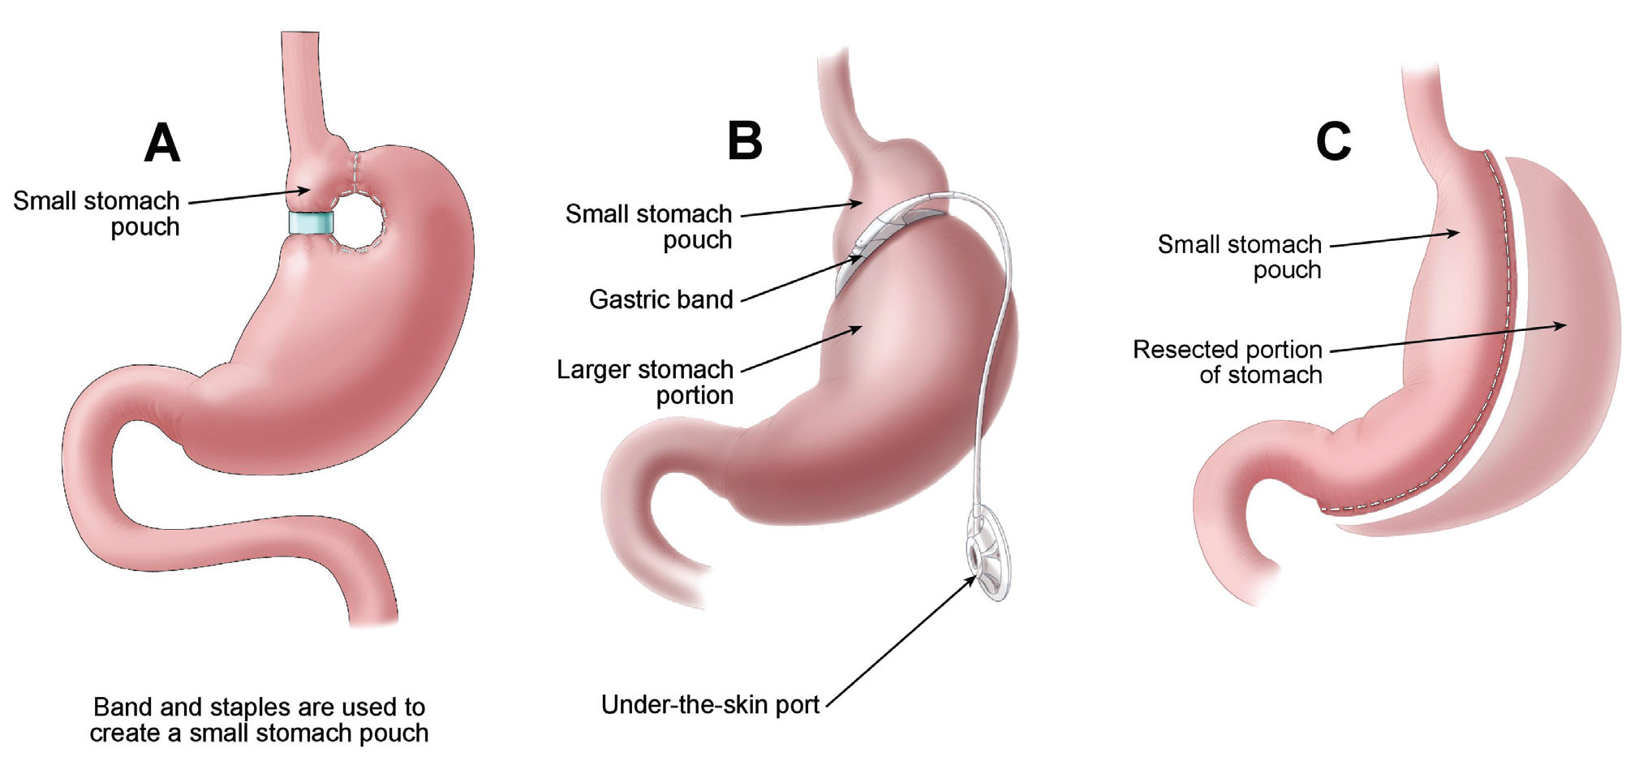
Restrictive Type
Vertical banded gastroplasty Surgical creation of a gastric pouch that can accommodate 25 to 30 mL and restricts the amount of food that can be consumed | Laproscopic adjustable gastric banding In this a band is placed around the stomach just below the esophageal gastric junction & tightened with a balloon filled with 15ml saline. Advantages: the tension on the band is adjustable & the system is removable | Sleeve Gastrectomy Decrease the size of the stomach to approximately 20% of its original size Gastric fundus and body is resected to form a tube like opening from the gastro esophageal junction to the pyloric valve. The reconstructed stomach will have a total volume of between 100 and 200 mL.
Notes:
VBG- surgical creation of small upper pouch of 25-30 ml from proximal part of stomach and distal to GE junction. This pouch communicates with the rest of stomach thru a narrow channel. This increase mechanical resistance to gastric emptying of ingested solids, whereas emptying of liquids proceed normally.
AGB:- This limits stomach capacity. Band can be made tighter or less by adding or removing saline. Adjustments made to meet pt individual wt loss needs.

Slide 30
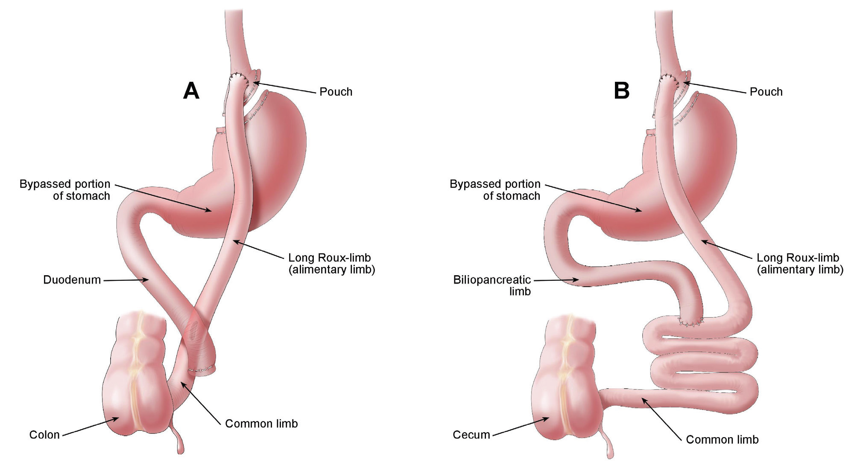
Roux-en-Y gastric bypass | Biliopancreatic Diversion With Duodenal Switch
Involves anastomosing the proximal gastric pouch to a segment of the proximal jejunum, bypassing most of the stomach and the entire duodenum. Advantages : Reversible Disadvantages: Leak from anastomosis Bowel obstruction Vitamin B12 Deficiency, anemia Intestinal Stenosis, Incisional hernia | Includes a hemigastrectomy or sleeve gastrectomy to create a 75- to 100-mL pouch. The ileum is connected directly to the gastric pouch, completely bypassing the duodenum and jejunum (alimentary limb). The distal portion of the biliopancreatic limb is then reconnected 100 cm from the ileocecal valve. Disadvantages: Gallstones & various deficiencies.
Notes:
This procedure allows the bypassed intestine to be exposed to bile and pancreatic juice. The antrum is removed to avoid peptic ulceration, and food intake is affected to only a limited degree.

Slide 31
A new procedure under investigation is an implantable gastric stimulator.
They are subcutaneously placed, cardiac pacemaker–like devices that stimulate regions along the lesser curvature of the stomach.
Electrical impulses stimulate smooth muscles of the stomach to stop peristalsis so that the patient feels full.
Implications of this procedure for anesthesiologist include possible lead dislodgement from violent stomach contractions due to postop nausea and vomiting. It can also cause artefacts in ECG monitoring.

Slide 32
Contraindications for Surgery
Unreasonable surgical risk
Untreated hypothyroidism
Gastrointestinal inflammatory disease (e.g., ulcers, Crohn disease, ulcerative colitis)
Severe cardiopulmonary disease
Pain intolerance to implantable devices
Alcohol and/or drug addiction
Severe cognitive disabilities
Allergy to silicone

Slide 33
Obesity Surgery–Mortality Risk Score
To predict the risk of mortality in patients undergoing bariatric surgery.
One point is assigned to each of 5 preoperative variables:
1. BMI 50 kg/m2 or more
2. Male gender
3. Hypertension
4. Risk for pulmonary embolism (history of venous thromboembolism, pulmonary hypertension, and/or obesity hypoventilation, presence of vena caval filter)
5. Older than 45 years
Score | Category | Mortality
0 or 1 | A or Low Risk | 0.2%-0.3%
2 or 3 | B or Intermediate risk | 1.1% - 1.5%
4 or 5 | C or High risk | 2.4%-3.0%

Slide 34
Anesthetic Management

Slide 35
Preoperative Assessment
Many morbidly obese patients have limited mobility and may therefore appear relatively asymptomatic!!!
despite having significant cardio-respiratory dysfunction
Focus on issues peculiar to the obese patient including evaluation of cardiorespiratory system and the airway.
Detailed history with previous anesthetic experiences and, if possible, records should be carefully recorded.
Wt., Ht.,BMI recorded in PAC chart.
Notes:
Lean body mass n ideal body mass to be calculated before hand for proper drug dosing intraoperatively.

Slide 36
Preoperative considerations
PAC:-
Look for HTN/DM/CCF/IHD/pulmonary HTN/OSA
AHI >30 implies severe sleep apnea, A warning sign and a predictor for rapid and severe desaturation at induction.
CPAP > 10 imply a patient with the potential for difficult mask ventilation.
Symptoms of acid reflux, coughing, inability to lie flat without coughing, or heartburn--- GERD
STOP BANG: Sleep Apnea questionnaire (Chung F et al Anesthesiology 2008 and BJA 2012)
Snoring, Tiredness, Observed apnea, blood Pressure, BMI, Age, Neck circumference, Gender
High risk of OSA: Yes 5 – 8
Intermediate risk of OSA: Yes 3 – 4
Low risk of OSA: Yes 0 - 2
Notes:
Pulmonary HTN-exertional dyspnea, fatigue,syncope----- reflect inability to increase cardiac output during activity. Prevent hypoxemia, avoid nitrous oxide intraop.

Slide 37
For repeat bariatric surgery
Screen for metabolic and nutritional abnormalities.
Acute postgastric reduction surgery neuropathy.
Electrolyte and coagulation indices
Evidence of OSA and OHS should be sought
associated with difficult laryngoscopy
patients on CPAP at home should be instructed to bring it with them as it may be needed postoperatively
Possibility of invasive monitoring, prolonged intubation, postop mechanical ventilation should be discussed.
Notes:
Vitamin and nutritional deficiencies can lead to a collective form of postop neuropathy c/as acute postgastric reduction surgery neuropathy (beri beri, Wernicke’s encephalopathy, vit B12 def., GullianBarre ds) attention for dosing n monitoring neuromuscular blocking agents.

Slide 38
Airway Assessment
Predictors of difficult intubation
Mallampatti score of 3 or more
Neck circumference > 40 cm at thyroid cartilage.
Thyromental distance <6 cm
High BMI
Decreased incisor gap
Sternal pad of fat
Limited mobility of TM joint or AO joint
Short thick neck
Large breasts

Slide 39
Recommended Lab investigations
Lipid profile
FBS
LFT
CBC
ECG/2D ECHO
RFT
VIT-B12
Ferritin
THYROTROPIN
PFT
Arterial blood gas measurements

Slide 40
Concurrent, preoperative, and prophylactic medications
Usual medications should be continued except insulin and OHA.
Antibiotic prophylaxis
Dexmedetomidine, because of its minimal respiratory depressant effects, may be considered for anxiolysis.
For aspiration pneumonitis:- H2 receptor antagonists, nonparticulate antacids, proton pump inhibitors used.
Nil by mouth – 12 hrs.
Evaluate for ease of intravenous access.
Prophylaxis against DVT.
Notes:
Antibiotic--- increased risk of wound infection in obese

Slide 41
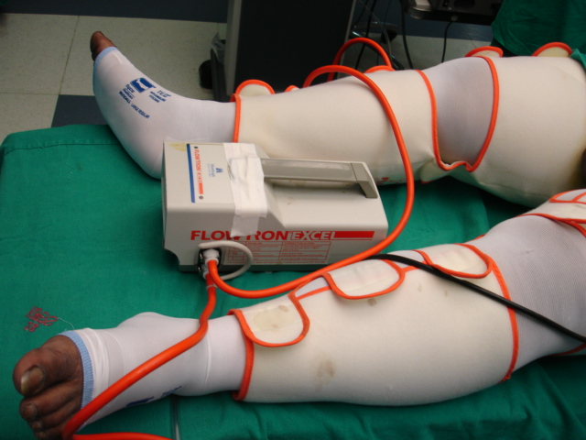
DVT Prophylaxis
Risk factors: venous stasis, BMI ≥60, truncal obesity, and OHS/OSA
Pharmacological - No standard recommendation
Mechanical – Sequential compression device
Heparin: 5000 units s/c every 8-12 hrs – 2 hr prior to surgery
and postoperatively until the patient is fully mobile.
LMWH: Enoxaparin 30mg BD upto 60mg twice a day
Prophylactic IVC filter – in high risk patient
Notes:
Low dose UFH

Slide 42
Intraoperative concerns

Slide 43
Positioning
Specially designed tables or two regular operating tables joined together
Operating tables capable of holding up to 455 kg, with a little extra width to accommodate the extra girth are now available.
Strapping obese patients to the operating table in combination with a malleable bean bag helps keep them from falling off the operating table.
Protecting pressure areas - pressure sores, neural injuries, and rhabdomyolysis (carpal tunnel syndrome).
Arms to be kept in neutral position to avoid excess pressure from tight tucking and draping.
Notes:
Regular operating tables hav maximum weight limit of approx. 205 kg

Slide 44
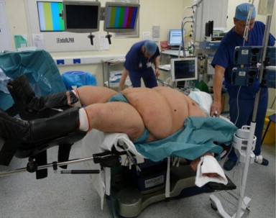
Supine positioning
Ventilatory impairment
Inferior vena cava and aortic compression.
FRC and oxygenation are decreased further.
Head-down positioning further worsens FRC.
Significant increase in oxygen consumption and cardiac output.
Rhabdomyolysis from pressure on the gluteal muscles leading to renal failure.
Notes:
The head up position provides the longest safe apnea period during induction of anesthesia. The xtra time gained may help preclude hypoxemia if intubation is delayed.

Slide 45
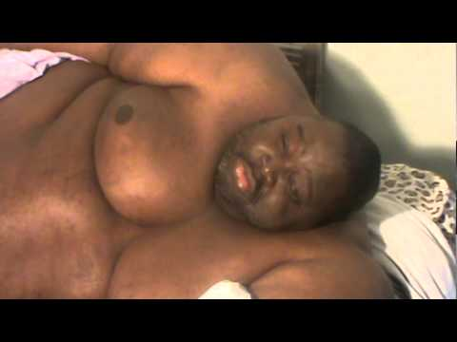
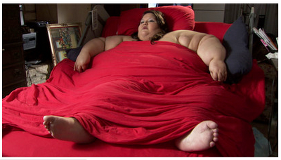
Head-up position & Intraoperative PEEP can
Decrease alveolar-arterial oxygen tension difference
Increase total respiratory compliance
Decrease peak and plateau airway pressures
Lateral decubitus position allows for better diaphragmatic excursion and should be favoured over prone positioning.
Notes:
Prone positioning, rarely required in the obese patient, should be correctly performed with freedom of abdominal movement to prevent detrimental effects on lung compliance, ventilation, and arterial oxygenation

Slide 46
Monitoring
Std monitoring
Invasive arterial pressure monitoring may be indicated for the morbidly obese.
For NIBP, cuffs with bladders that encircle a minimum of 75%of upper arm circumference or, preferably the entire arm should be used.
BIS and entropy monitoring to titrate depth of anesthesia.
Monitoring of neuromuscular junction.
Central venous catheterization may also be required for intravenous access.
Notes:
Invasive arterial pressure monitoring may be indicated for the super morbidly obese patient, for those patients with cardiopulmonary disease, and for those patients on whom the noninvasive blood pressure cuff may not fit properly. Blood pressure measurements can be falsely elevated if a cuff is too small. Cuffs with bladders that encircle a minimum of 75% of the upper arm circumference or, preferably, the entire arm, should be used. Forearm measurements with a standard cuff overestimate both systolic and diastolic blood pressures in obese patients

Slide 47
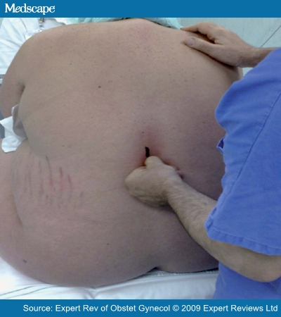
Choice of anesthesia
Acc. to ASA practice guidelines, local or regional anesthesia should be the primary anesthetic choice for obese, with GA used only when necessary.
Regional anesthesia
May be difficult with standard equipment and techniques due to;
Obscured landmarks
Difficult positioning
Extensive layers of adipose tissue
Engorged extradural veins and extra fat constricting the potential space, less local anaesthetic 75-80% of the normal dose is needed for epidurals
Leave extra catheter in the space as it may be subject to drag as the flexed patient relaxes.
Notes:
Adv is dectrease use of narcotics for postop pain
The height of a SAB can be unpredictable because of considerable upward spread within a short time, causing cardiorespiratory compromise.
Longer needles and the sitting position are other useful tools that facilitate central neuraxial anesthesia.

Slide 48
Induction, intubation, and maintenance
Adequate preoxygenation is vital & performed with 10 L/min of oxygen to avoid rapid desaturation.
Application of PPV during preoxygenation decreases atelectasis formation and improves oxygenation.
4 vital capacity breaths with 100% O2 within 30 seconds have been suggested as superior to the usually recommended 3 minutes of 100% preoxygenation in obese patients.
Larger doses of induction agents may be required
Increased dose of Sch is necessary because of an increase in activity of pseudocholinesterase.
Notes:
Adequate preoxygenation is vital because of rapid desaturation after loss of consciousness due to increased O2 consumption and decreased FRC.
Application of positive pressure ventilation during preoxygenation decreases atelectasis formation and improves oxygenation
4 vital capacity breaths with 100% O2 within 30 seconds have been suggested as superior to the usually recommended 3 minutes of 100% preoxygenation in obese patients
Large amt of induction agents d/to increased blood volume, ms mass, cardiac output.

Slide 49
Intubation/Airway Management
If a difficult intubation is anticipated, awake intubation is a prudent approach.
Sedative-hypnotic in minimal doses.
Sedation with Dexmedetomidine provides adequate anxiolysis and analgesia without respiratory depression.
Hypoxia and aspiration of gastric contents should be prevented at all costs.
Call for an experienced assistant.
Be ready with difficult airway cart.
Notes:
An experienced colleague who is immediately available or, better still, in the room during induction and airway management can help with mask ventilation or attempts at intubation.
A surgeon capable of accessing the airway surgically should be readily available.

Slide 50
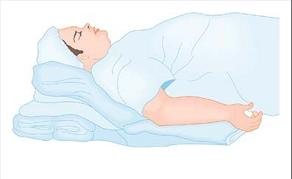
Stacking
Towels or folded blankets under the shoulders and head can compensate for the exaggerated flexed position of posterior cervical fat.
This position is known as “STACKING so that the tip of the chin is at a higher level than the chest to facilitate laryngoscopy and intubation.

Slide 51
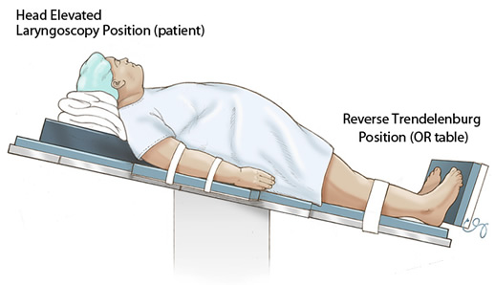
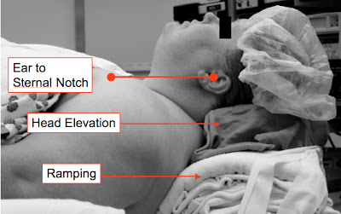
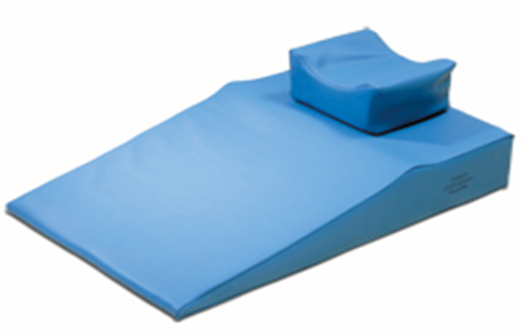
Head elevated Laryngoscopy position (HELP)
Preformed Troop Elevation Pillows can be used.
Notes:
The HEAD-ELEVATED LARYNGOSCOPY POSITION (HELP){RAMPING} is a step beyond stacking.
It significantly elevates the obese patient's head, upper body, and shoulders above the chest to the extent that an imaginary horizontal line connects the sternal notch with the external auditory meatus to better improve laryngoscopy and intubation.

Slide 52
RAMPING ADVANTAGES:
Improves laryngoscopic view
The gradient for passive regurgitation is reduced
The safe apnea period is increased.
25-30° reverse trendelenburg position with manual PEEP/NIPPV improves oxygenation.
Maintenance
Continuous infusion of a short-acting intravenous agent, such as Propofol, or any of the inhalation agents, or a combination, may be used.
Inhalational agents that are minimally metabolized are useful agents, with Desflurane possibly providing better hemodynamic stability and faster washout.
Notes:
Inhalational agents r des, sevo, iso…

Slide 53
Rapid elimination and analgesic properties make N₂O an attractive choice, but high oxygen demand limits its use.
Short-acting opioids, combined with a low-solubility inhalation agents, facilitate a more rapid emergence without increasing opioid-related side effects.
Cis-atracurium possesses an organ-independent elimination profile and is a favorable NDMR for use during maintenance.
Dexmedetomidine with sedative and analgesic properties, is an attractive anesthetic adjunct in obese patients.

Slide 54
Intra Operative Ventilatory Management
Prevent/reverse atelectasis
Restrict the use of Fio2 to < 0.8 during
Maintain lung recruitment
Use PEEP (10-12 cm/H2O)
Avoid lung overdistension
Use tidal volume of 6-10 mL/kg of ideal body weight
Keep peak-inspiratory pressure < 30 cm/H2O
Consider mild permissive hypercapnia if necessary
Notes:
PEEP increase oxygenation

Slide 55
Fluid management:
Adequate preoperative hydration and higher intraoperative fluid administration (20-40 ml/kg) reduce postoperative complications.
Excess adipose tissue may mask peripheral perfusion, making fluid balance difficult to assess.
Blood loss is usually greater.
Early infusion of colloids and blood products may be necessary because they are less able to compensate for small volumes lost,
but rapid infusion of excessive amounts should be avoided because pre-existing CCF is common
Notes:
Obese pt can be hypovolemic ---- d/to bowel preparation n prolonged preop fasting. In addition they may be receiving antihypertensive drugs l/to hypotension at induction. This risk couple with propensity of postop acute renal failure , highlights importance of fluid management.

Slide 56
Intragastric calibration tube
Used instead of a Ryle’s tube.
Bilumen tube with one port for suction and another port in which 15-20ml of saline is injected to inflate the intragastric balloon.
This balloon enables the surgeon to place the gastric band just below the esophagogastric junction which is then tightened and helps in deciding the size of the gastric pouch.
Remove all NG tubes before gastric division to avoid unplanned stapling & transection of these devices.
Later leak test is performed with 50ml methylene blue with saline to ensure anastomotic integrity. At this time the cuff should be tight seal otherwise aspiration of dye can occur leading to chemical pneumonitits.
After anastomosis, if NG tube is inserted it should be done by watching on monitor otherwise disruption of anastomosis can occur.

Slide 57
EMERGENCE
Prompt extubation reduces the likelihood of ventilator-dependence.
Patient should be fully awake, follow oral commands, have adequate muscle strength, Adequate tidal volume and brisk airway reflexes.
Reverse residual neuromuscular blockade.
Extubate in the same position as for intubation.
Placement of tube exchanger before extubation in high risk cases.
Supplemental oxygen should be administrated after extubation.

Slide 58
There is an increased incidence of atelectasis in postoperative period.
Initiation of CPAP ------> ↑ FRC, improve lung compliance, improve ventilation & oxygenation,↓ upper airway obst & ↓ WOB
No increase of risk of major anastomotic leakage after gastric bypaas surgery.
Adequate analgesia, use of a properly fitted elastic binder for abdominal support, early ambulation, deep breathing exercises, and incentive spirometry are all useful adjuncts.
Pulse oximetry and ABG should be monitored appropriately.

Slide 59
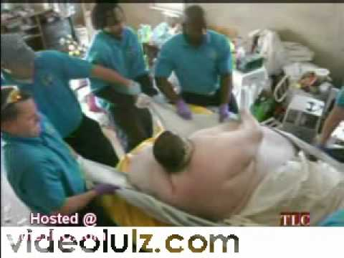
Lifting and transfering
Air transfer mattress
device (eg, Hover-Matt)
In sitting or semi upright
position
Supplemental O2
Pulse oximetry

Slide 60
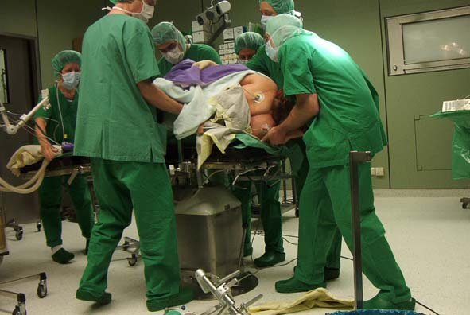
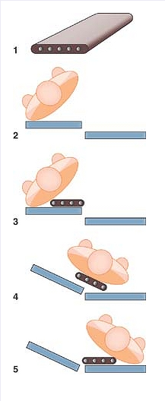
Lifting and transfering
Walter Henderson Maneuver
Notes:
Lifting ,The Patient Transfer Device, and mechanical lifting devices that use a sling are useful for transporting morbidly obese patients onto or off the operating table.
Walter Henderson maneuver:----- pt. roller, pt tilted to slip roller underneath, roller slipped under patient, table tilted to roll pt. downhill onto bed, pt. rolled onto bed

Slide 61
Management of postoperative pain
Is very challenging.
Morbidly obese patients have exaggerated respiratory depression from opioids.
In patients with obstructive sleep apnea – opioid sparing techniques help avoid respiratory complications.
A multimodal approach is best. It include
Peripheral and central nv block with continuous infusion of LA + opioids
NSAIDs (ketorolac), acetaminophen
α2 agonists, NMDA receptor antagonists, sodium channel blockers
Local anesthetics injected into the wound or port site,
Infusion of dexmedetomidine decreases postoperative opioid requirements.
Recent technique is the continuous intraperitoneal infusion of bupivacaine.
Notes:
Multimodal approach include techniques tat decrease narcotic requirements.
NMDA antagonist (ketamine, methadone)

Slide 62
Summary
Obesity is a major healthcare challenge
Daily challenge for anesthetists
Obese patients are at risk from comorbidities and pathophysiological changes of obesity
Bariatric surgery is a beneficial and cost-effective healthcare intervention

Slide 63
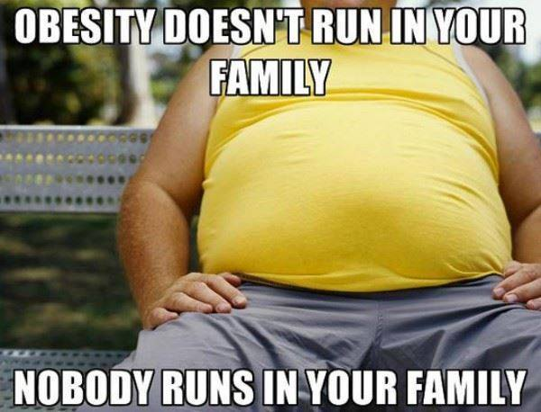

Slide 64
Duration of CPAP | EFFECT
2 weeks | Corrects abnormal ventilatory drive
3 weeks | Increases LVEF in CHF
4 weeks | Reduces B.P, HR, 35% increase in E.F
4-6 weeks | Reduced tongue volume & increased pharyngeal space
8 weeks | Reduction in CVS risk
3-6 months | Reduction in PAH

Slide 65
OHS vs OHA
PARAMETER | OHS | OSA
Gender | Males = females | Males > females
Obesity (BMI ≥30 kg/m²) | Yes | May be
Ventilation pattern | Hypoventilation | Normal
PaCO₂ (mm Hg) | Increased (>45 mm Hg) | Normal (increased during apnea)
Pao₂ (mm Hg) | Decreased; most severe during REM sleep | Normal (decreased during apnea)
Sao₂ (%) | Decreased | Normal (decreased during apnea)
Nocturnal upper airway obstruction | No | Yes
Pulmonary hypertension | More common and severe | Less common
Nocturnal monitoring | Increased PaCO₂ during sleep to >10 mm Hg from awake supine values. O₂ desaturation during sleep not explained by apnea or hypopnea | ≥5 obstructive breathing events per hour of sleep

Slide 66
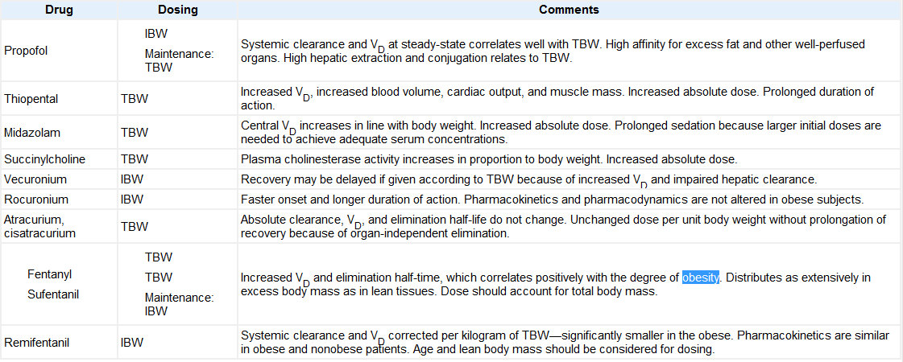

Slide 67
Medical Therapy for Obesity
Phentermine – serotonin reuptake inhibitors
Causes anorexia and increase resting metabolic rate
Side effects: pulmonary hypertension with valvular heart disease, HTN, tachycardia.
Others are fenfluramine, dexfenfluramine
Sibutramine – mixed serotonin/norepinephrine/dopamine reuptake inhibitor. It increase satiety after onset of eating rather than decreasing appetite. S/Es slight HTN, tachycardia, dry mouth, insomnia, increased risk of heart attack and stroke.

Slide 68
Newer Antiobesity drugs
Orlistat:- Lipase inhibitor in the GI tract.
Inhibits fat absorption in intestine.
Also improves cardiovascular risk factors associated with obesity.
Side effects: fecal urgency, diarrhea, abdominal pain, liver injury.
Chronic dosing leads to increase in warfarin’s anticoagulant effect bcoz of decrease absorption of Vitamin K. (def. of clotting factors II, VII, IX, X). This leads to abnormal PT with a normal PTT.
Rimonabant:- Selective cannabinoid 1 receptor antagonist.
Decrease appetite
Decrease incidence of metabolic syndrome
S/Es:- anxiety, depression, nausea, dizziness, diarrohea, arthralgia
Notes:
Shuld be treated 6-24 hrs before surgery either with vit k analogue or with FFP in emergency.

Slide 69
Complications Associated With Bariatric Surgery
Adjustable gastric band | Malabsorptive procedures | Potential complications of both types of procedures
Gastric mucosal erosion around the band Gastritis Erosion of gastric mucosa under the band, causing perforation Filling port malfunction Gastric prolapse Malposition of the band Barrett esophagus Dysphagia Gastroesophageal reflux | Bowel obstruction Wound dehiscence Leakage and/or ulcers at the sites of anastomosis Nutritional deficiency Incisional hernia Gastrojejunostomy stenosis | Hemorrhage Dumping syndrome (more common in gastric bypass) Postoperative respiratory insufficiency Deep vein thromboembolism Pulmonary embolism Sepsis
Notes:
Nutritional def. like vit B12, anemia, Vit K- give supplements

Slide 70
Ventilatory Strategy
Large tidal volume (15-20ml/IBW) – higher than closing volume → ↑ arterial O₂ tension
Oberg B. Acta Anesthesiol Scand 1996, Shenkman Z. BJA 1993
Large TV → ↓ PaCO₂, resp. alkalosis, CV impairment & excessive stretching of nondependent lung region
Dumont L. Acta Anesthesiol Scand 1997, Bradoczky GI. Anesth Analg 1995
Large TV – do not improve oxygenation Bradoczky GI. Anesth Analg 1995
TV > 13 ml/kg IBW – no added advantage Bardoczky et al. Anesth Analg 1995
10-12 ml/kg TV RR 12-14 /min moderate PEEP Ogunnaike et al. Anesth Analg 2002

Slide 71
Limitations of BMI
Not a direct measure of adiposity
No account of fat distribution
No account of duration of obesity
Inaccurate at extremes of height
Inaccurate with extremes of lean body mass (eg athletes, elderly)
Waist or collar circumference more predictive of cardio-respiratory comorbidity
Notes:
Athletes like who have more ms mass can be easily classified as overweight using BMI.

